Slide 1
The Effect of Stress Level and Physical Activity on Sleep Duration
Jessica Morris, Nicholai Shaw, Cassie Nichols

Slide 2
Introduction
A sleep analysis revealed that as many as 50% of adults report difficulty initiating and maintaining sleep (Crowley, 2011)
Just under 20% of American adults report excessive daytime drowsiness in recent samples (Slater, & Steier, 2012)
Sleeping less than seven hours each night is associated with increased risk for diabetes, heart disease, and overall mortality (Liu et al., 2016)
In addition, poor sleep habits are associated with mental dysfunction and poor cognitive performance (Liu et al., 2016)
How can Americans increase their sleep habits?

Slide 3
Data Exploration (Physical Activity Level and Sleep)
Thirty eligible participants’ physical activity and sleep habits (duration) were collected and exported into a public dataset on Kaggle (Möbius, 2020)
Physical activity levels (sedentary, lightly active, fairly active, and very active) were compared against sleep duration
Kaggle is a platform favored by data scientists used to host and share datasets

Slide 4
Data Exploration (Self-Reported Stress Level and Sleep)
Data of 374 participants’ sleep habits, stress levels, and heart rate were collected and posted on Kaggle (Tharmalingam, 2023)
No cleaning was required on this dataset
Participant’s reported stress level was analyzed with sleep duration
Participant’s heart rate level was analyzed with sleep duration as a physiological measure of stress
Participant’s heart rate were analyzed and compared to their stress levels to validate if stress and heart rate were correlated

Slide 5
Question #1
What is the relationship between physical activity level and duration of sleep?

Slide 6
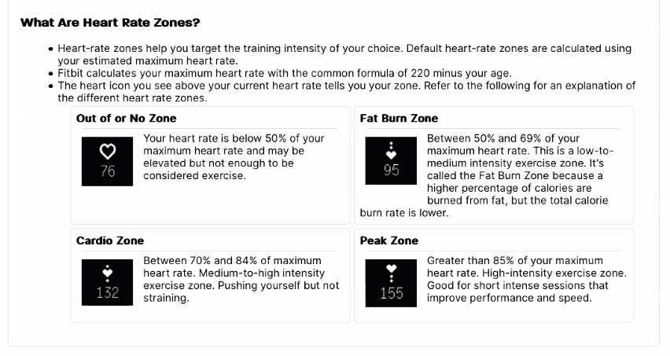
Physical activity level can be group into four categories:
These categories are based on heart rate zones during activity.
Sedentary
Lightly Active
Fairly Active
Very Active

Slide 7


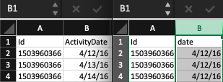
Cleanup Process
Merge our sleep_csv and daily activity_csv on ID and date
Changed date format directly in the csv file using Format Cells

Slide 8
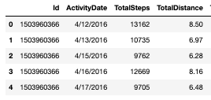
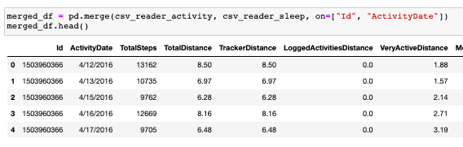
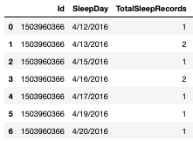
Cleanup Process
Renamed column “SleepDay” to “ActivityDate” to merge our “csv_activity” and “csv_sleep” using .rename function
Inner merge

Slide 9
Cleanup Process
Converted sleep duration and activity level duration measurements from minutes to hours

Slide 10
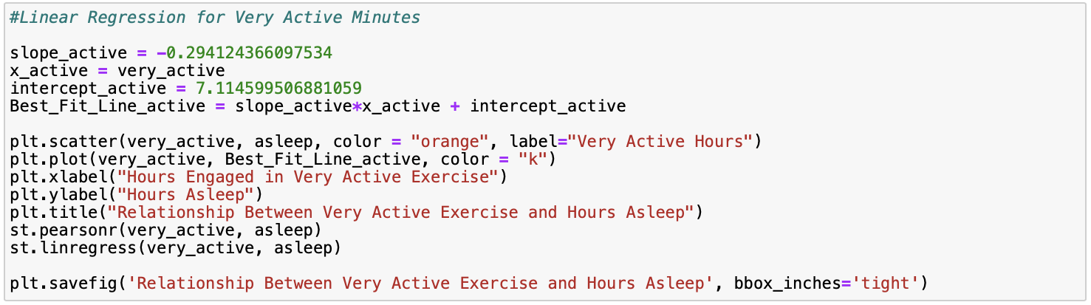
Relationship Between Very Active Exercise & Hours Asleep
(Jupyter Notebook script)

Slide 11
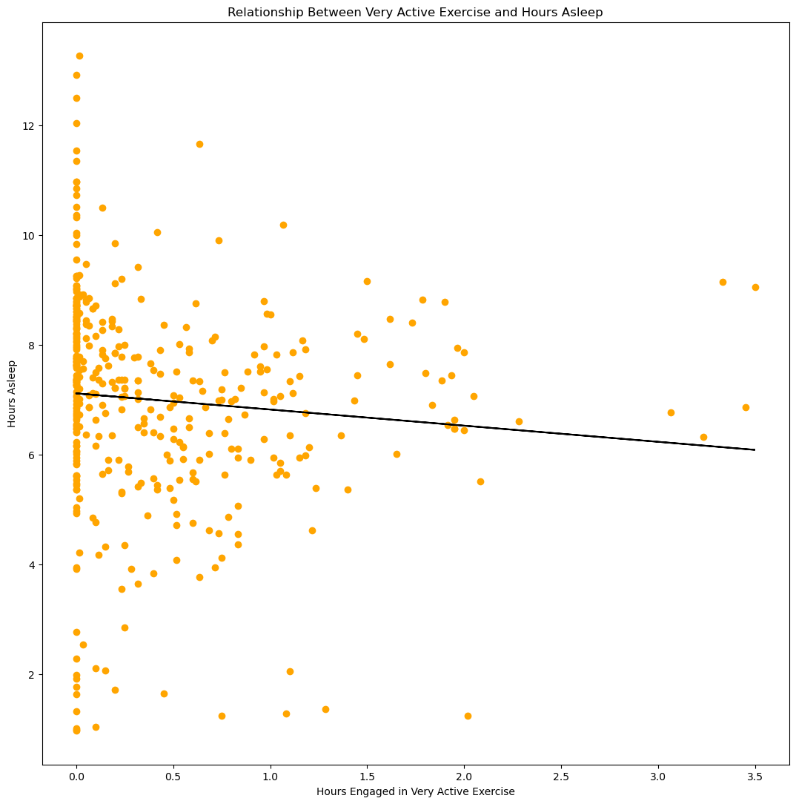
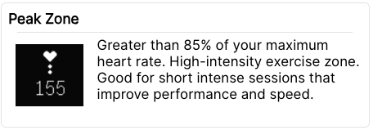
Relationship Between Very Active Exercise & Hours Asleep
No significant association between vigorous activity and hours asleep
Rvalue = -0.090
Pvalue = 0.066

Slide 12
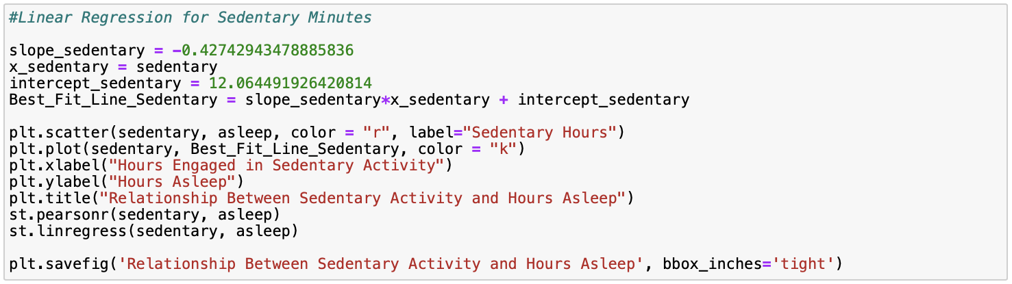
Relationship Between Sedentary Activity & Hours Asleep
(Jupyter Notebook script)

Slide 13
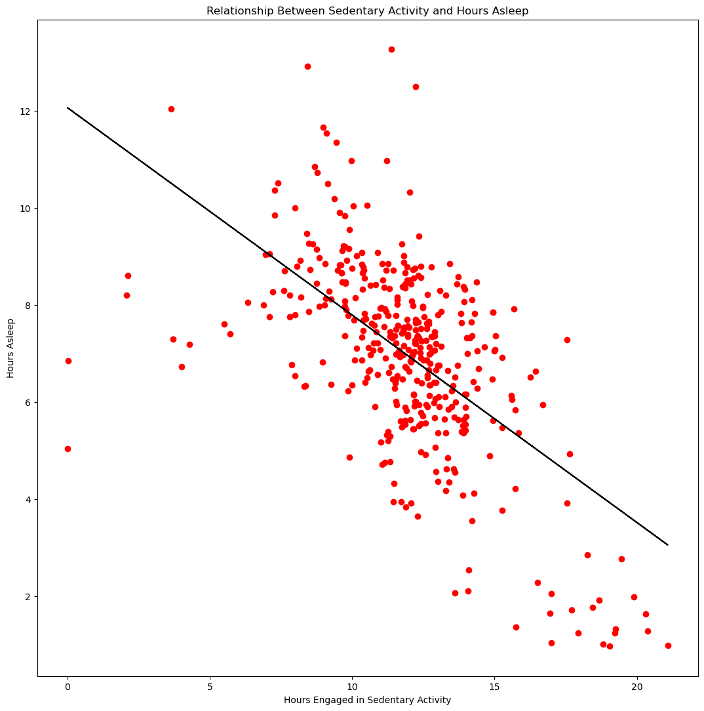
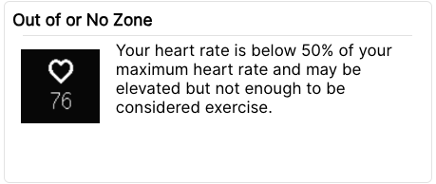
Relationship Between Sedentary Activity & Hours Asleep
A significant negative association between hours of sedentary activity and hours asleep
Rvalue = -0.599
Pvalue = 1.220e-41

Slide 14
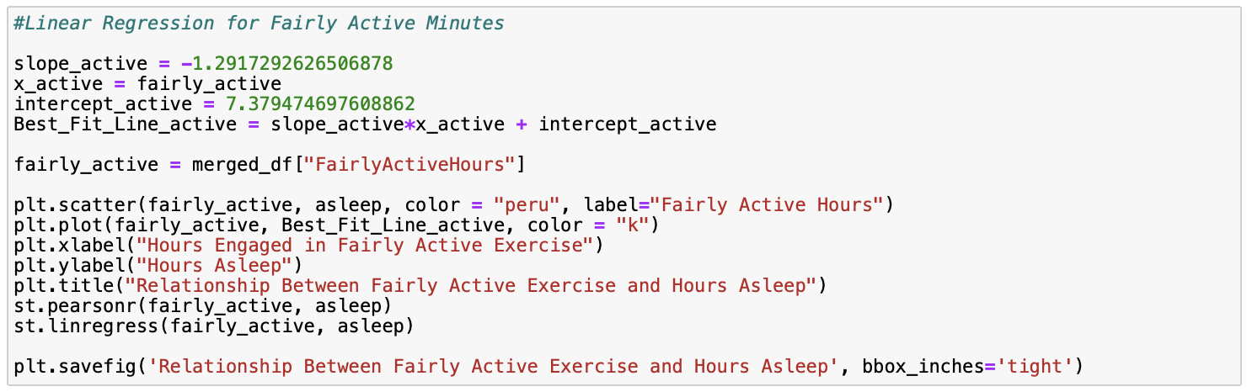
Relationship Between Fairly Active Exercise & Hours Asleep
(Jupyter Notebook script)

Slide 15
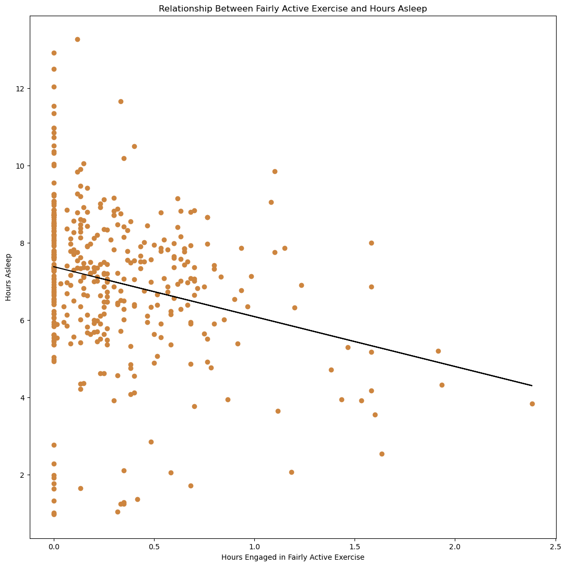
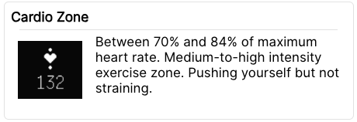
Relationship Between Fairly Active Exercise & Hours Asleep
A significant association between hours engaged in fairly active exercise and hours asleep
Rvalue = -0.245
Pvalue = 4.877e-07

Slide 16
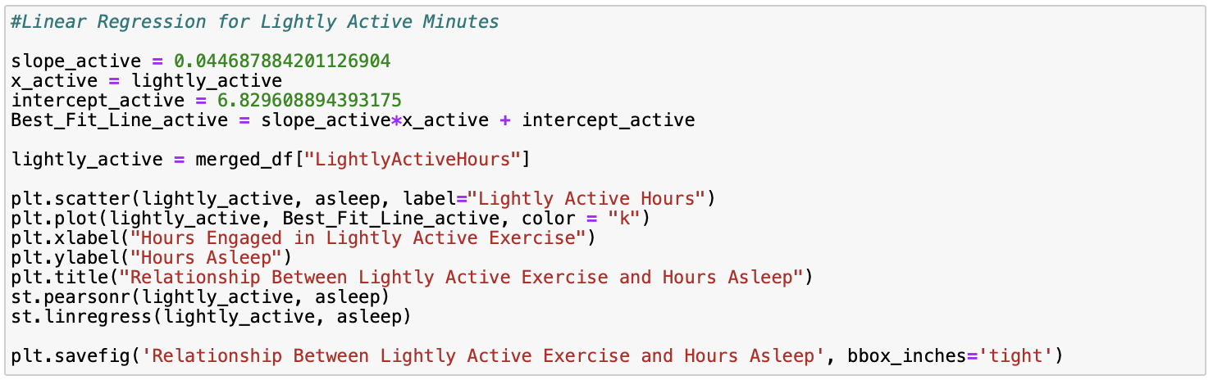
Relationship Between Lightly Active Exercise & Hours Asleep
(Jupyter Notebook script)

Slide 17
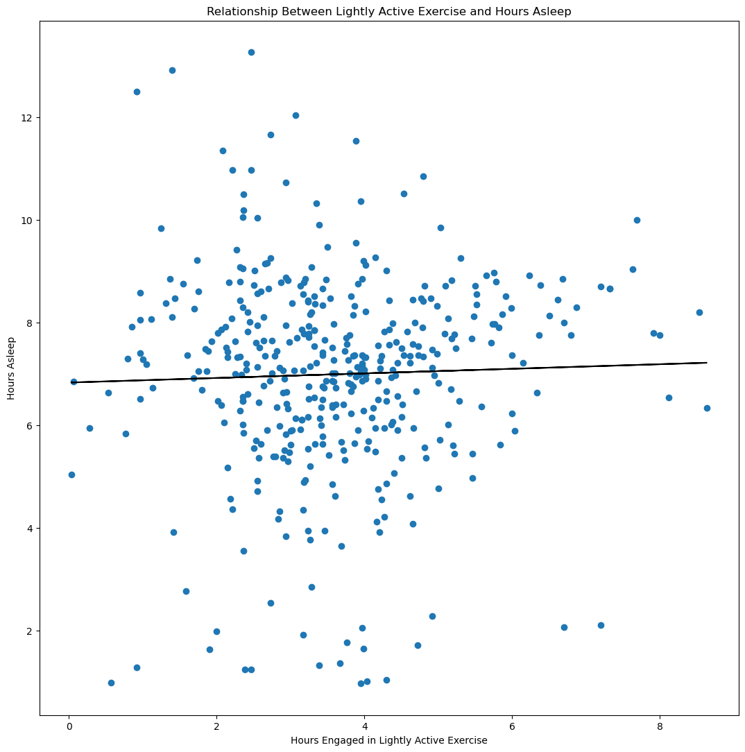
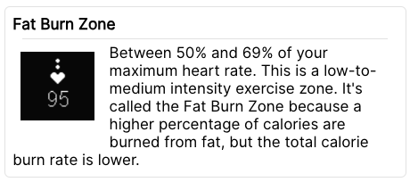
Relationship Between Lightly Active Exercise & Hours Asleep
No association between lightly active exercise and hours asleep
Rvalue = 0.033
Pvalue = 0.505

Slide 18
Question #2
How does stress level impact duration of sleep?

Slide 19
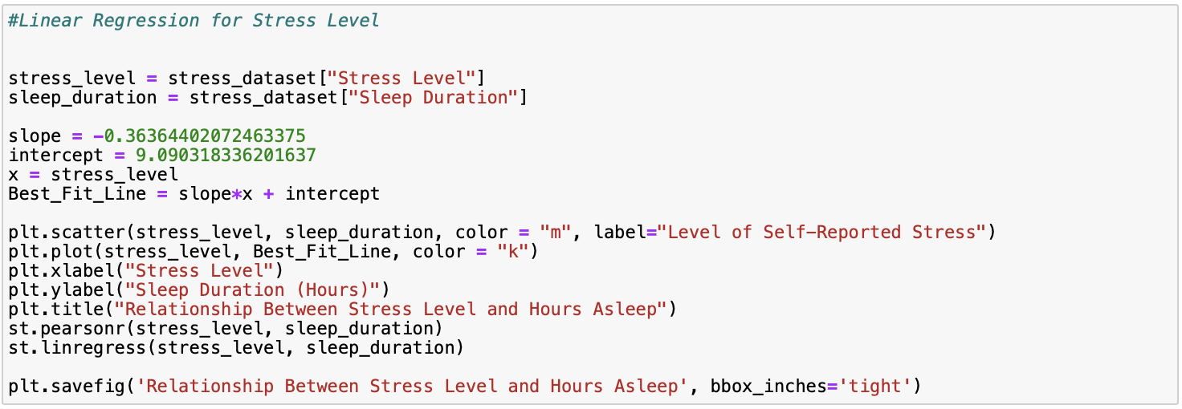
Relationship Between Stress Level & Hours Asleep
(Jupyter Notebook script)

Slide 20
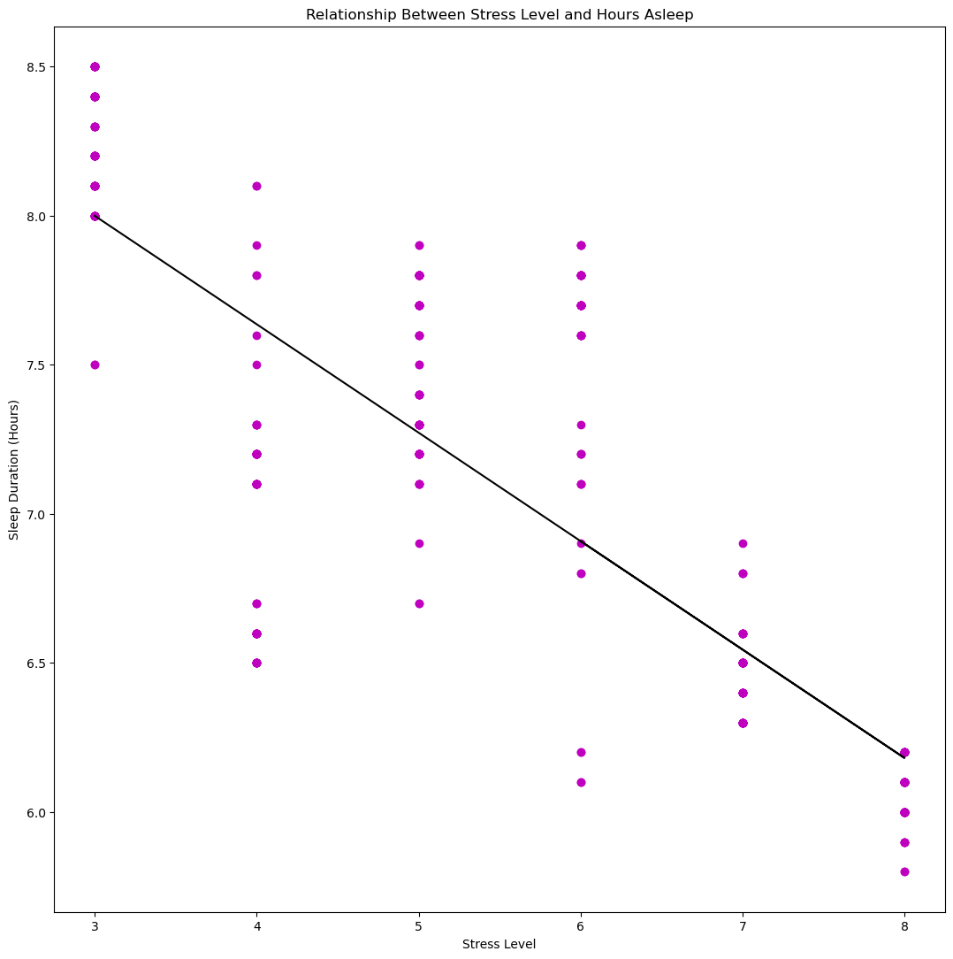
Relationship Between Stress Level & Hours Asleep
A significant relationship exists between stress level and sleep duration
Rvalue = -0.811
Pvalue = 1.238e-88

Slide 21
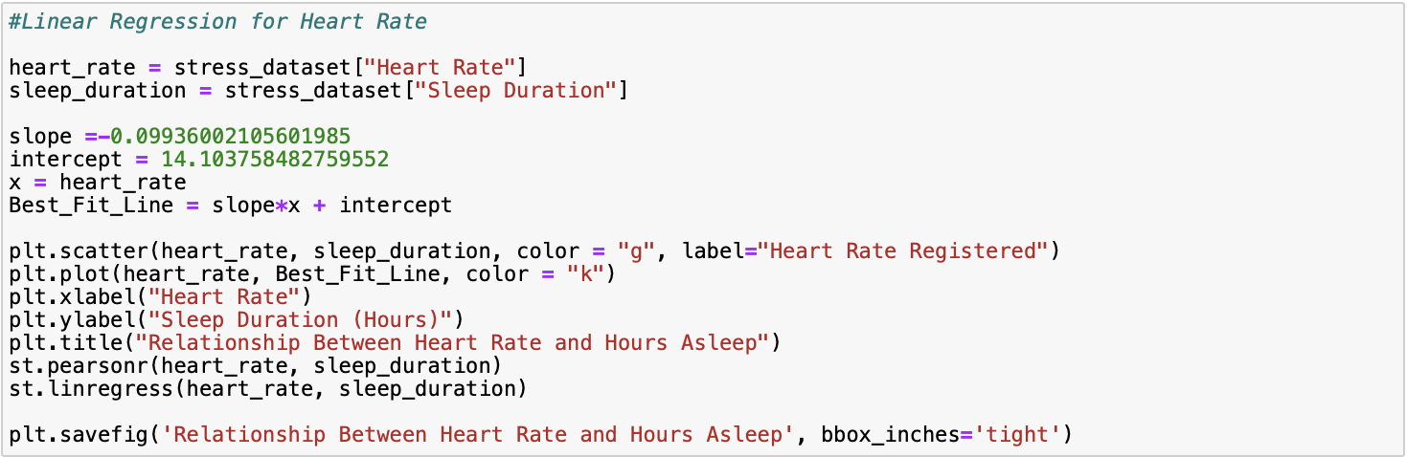
Relationship Between Heart Rate & Hours Asleep
(Jupyter Notebook script)

Slide 22
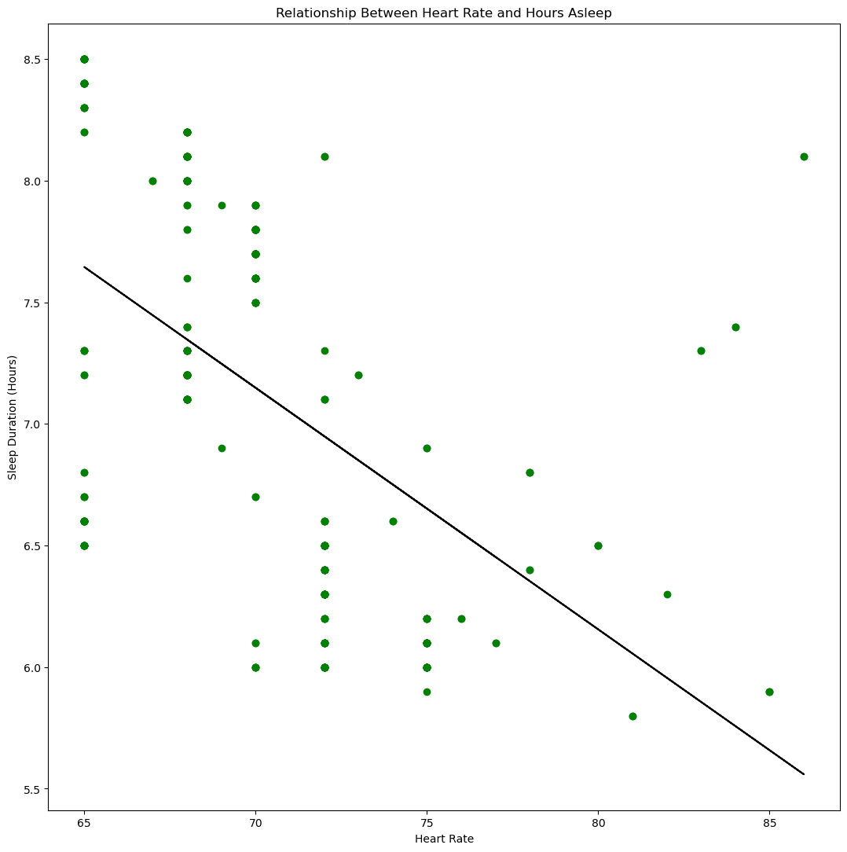
Relationship Between Heart Rate & Hours Asleep
A significant association between heart rate and hours asleep
Rvalue = -0.516
Pvalue = 6.915e-27

Slide 23
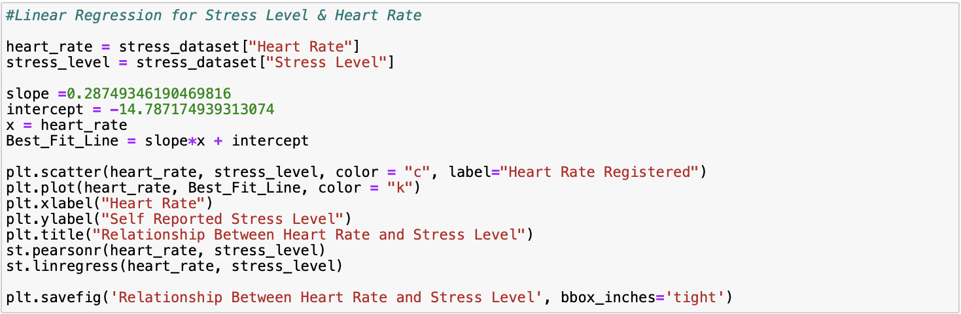
Relationship Between Heart Rate & Stress Level
(Jupyter Notebook script)

Slide 24
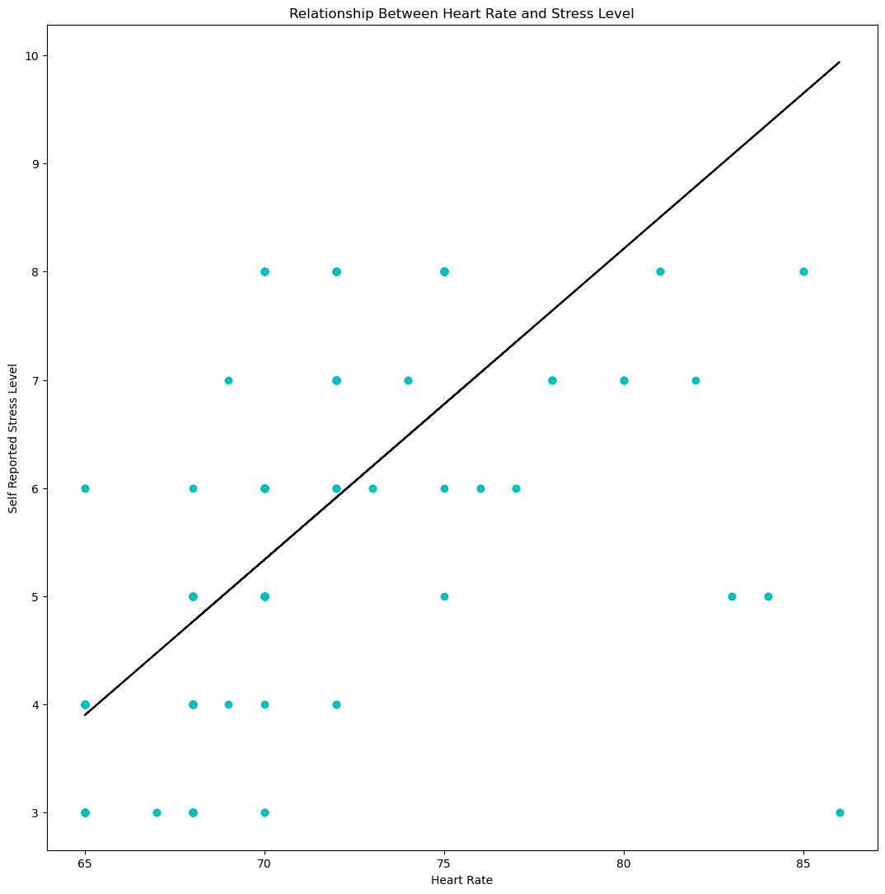
Relationship Between Heart Rate & Stress Level
Significant association between heart rate and stress level
Rvalue = 0.670
Pvalue = 4.492e-50

Slide 25
Conclusions
We fail to reject the null hypothesis that vigorous exercise has no effect on sleep duration
We reject the null hypothesis that sedentary activity has no effect on sleep duration
We reject the null hypothesis that self-reported stress level has no effect on sleep duration

Slide 26
References
Crowley, K. (2011). Sleep and sleep disorders in older adults. Neuropsychology review, 21, 41-53.
Liu, Y., Wheaton, A. G., Chapman, D. P., Cunningham, T. J., Lu, H., & Croft, J. B. (2016). Prevalence of healthy sleep duration among adults—United States, 2014. Morbidity and Mortality Weekly Report, 65(6), 137-141.
Möbius. (2020, December 16). Fitbit Fitness Tracker Data. Kaggle. https://www.kaggle.com/datasets/arashnic/fitbit
Slater, G., & Steier, J. (2012). Excessive daytime sleepiness in sleep disorders. Journal of thoracic disease, 4(6), 608.
Tharmalingam, L. (2023, May 26). Sleep health and lifestyle dataset. Kaggle. https://www.kaggle.com/datasets/uom190346a/sleep-health-and-lifestyle-dataset

